Slide 1
Predicting the price of Bitcoin
Rojesh Dhakal

Slide 2
Disclaimer
Not a financial adviser

Slide 3
Who am I?
FPPT.com

Slide 4
CONTEXT
CONTEXT

Slide 5

Business Question

Slide 6

Importance of Question

Slide 7

DATA PIPELINE

Slide 8





DATA OVERVIEW
YFINANCE
DATA FROM 2014-2023
7 FEATURES CLEAN DATA
3200 ROWS AND COLUMNS

Slide 9
DATA PREPROCESSING
DATA FORMATTING
STANDARDIZATION

Slide 10
EXPLORATORY DATA ANALYSIS
ADF Statistic: -1.549358057144826 p-value: 0.5089688390430713
Since p-value is more than 0.05, we can infer that its not stationarity therfore we need to find the order of differencing.

Slide 11
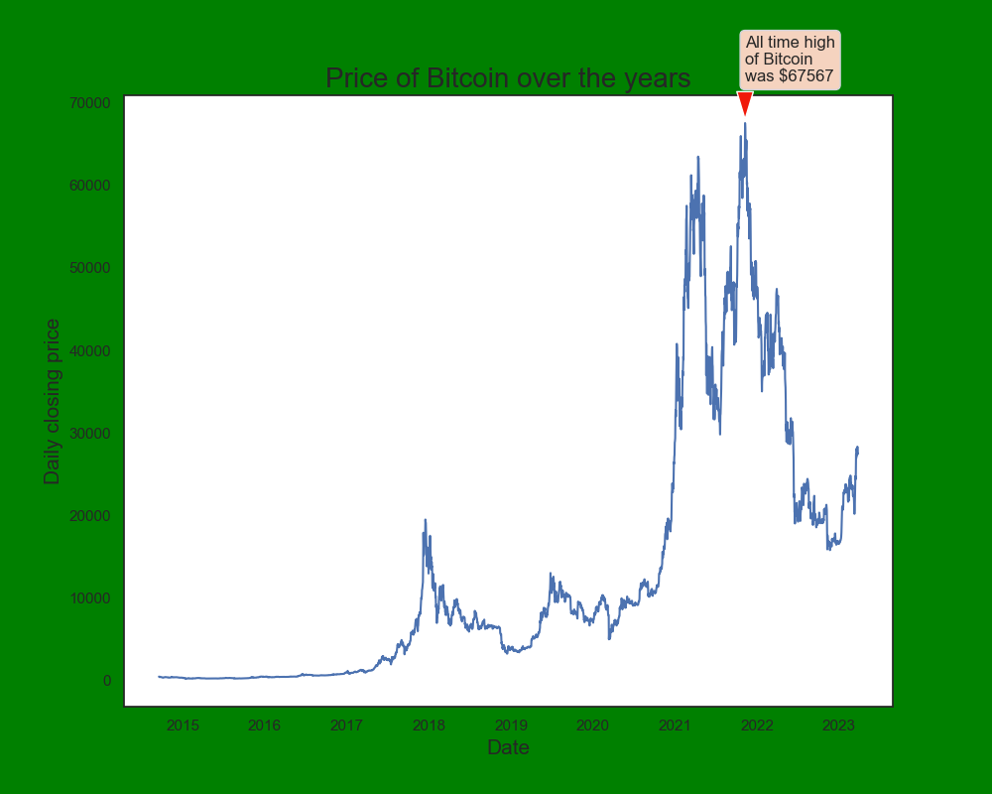

Slide 12
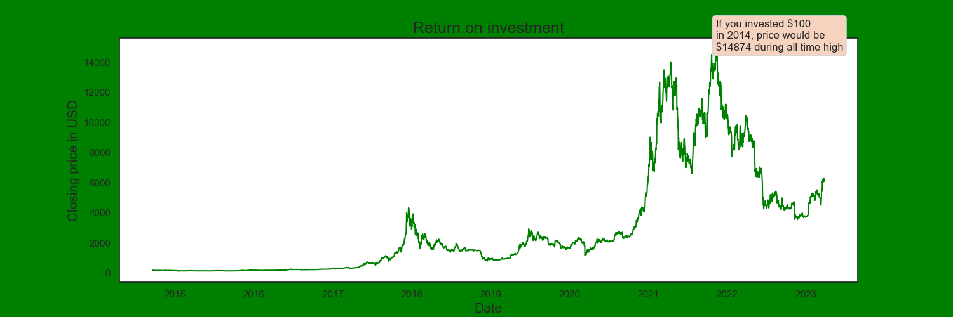

Slide 13
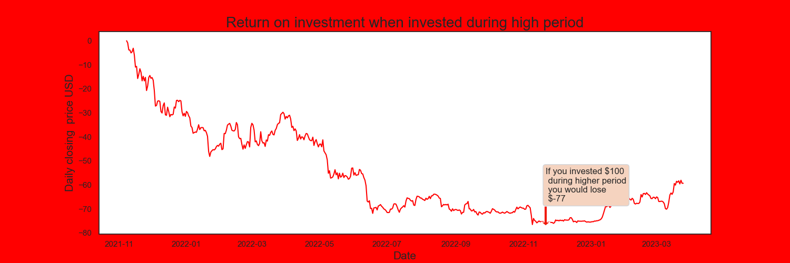

Slide 14
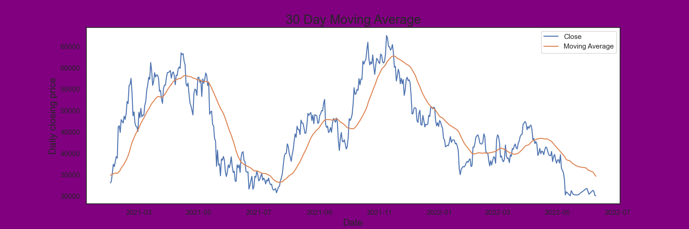

Slide 15
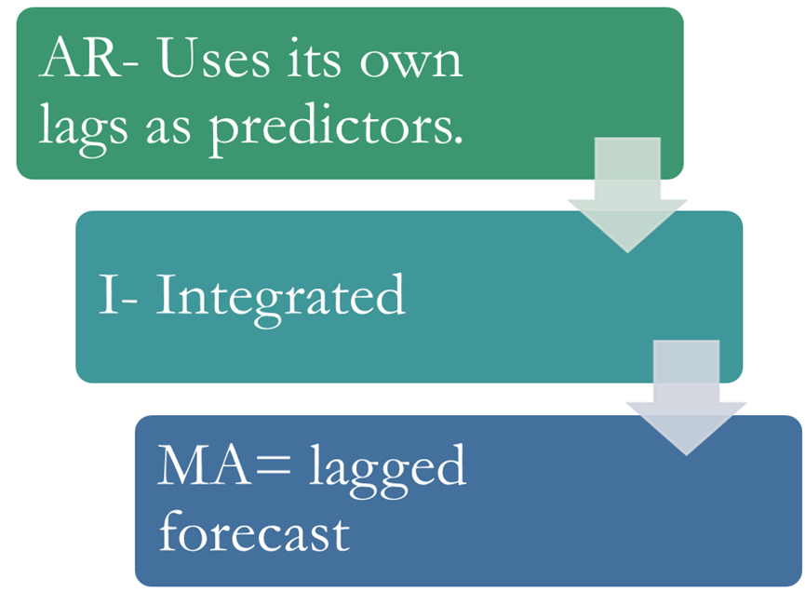
ARIMA Model

Slide 16
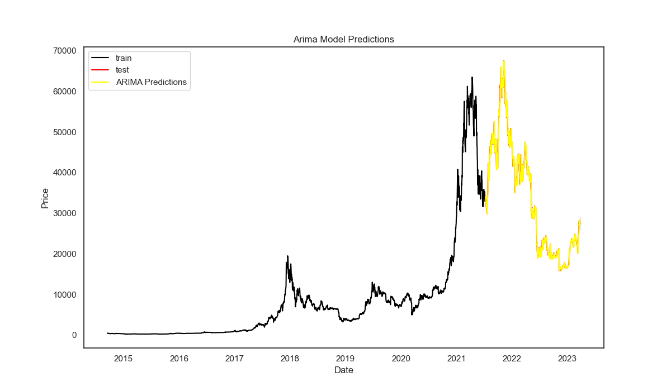
Prediction
RMSE
MAPE

Slide 17
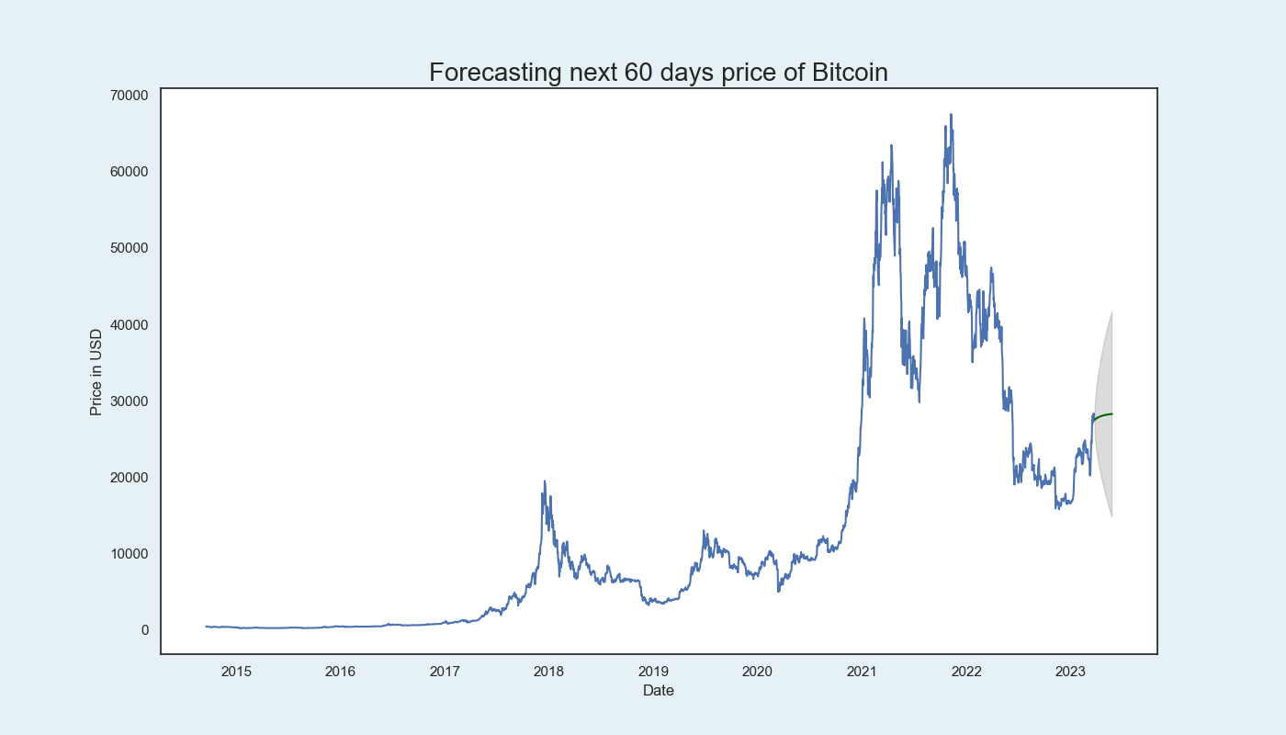
Forecasted

Slide 18
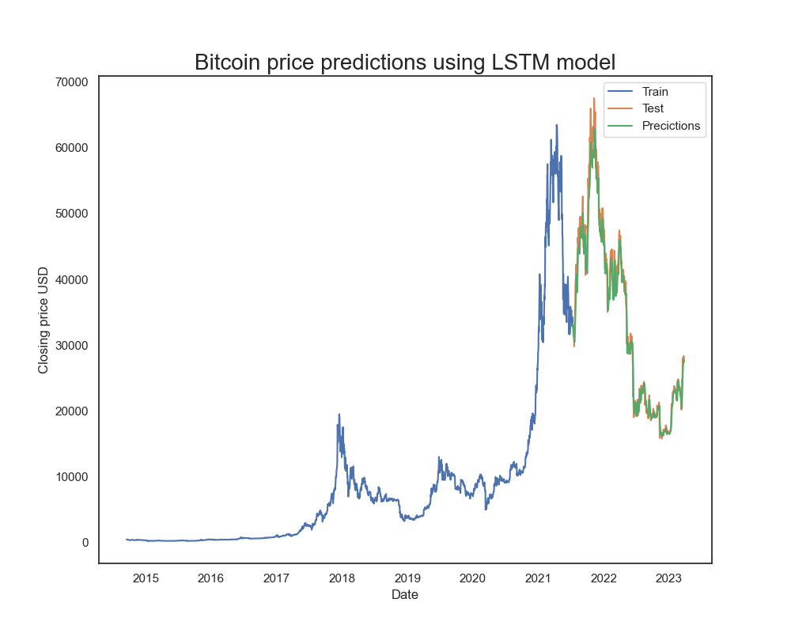
LSTM
LSTM
RMSE
MAPE

Slide 19
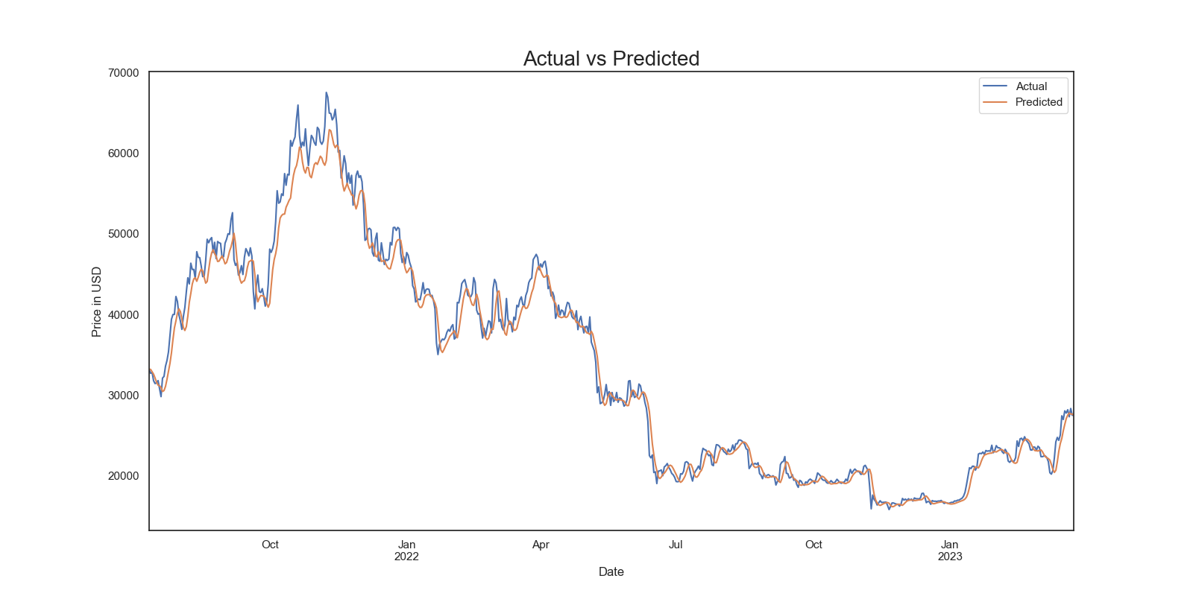
Actual Vs Prediction

Slide 20
Conclusion and Future Improvements
Conclusion
Future Improvements

Slide 21


